Slide 1

Crime Rate Prediction Using Machine Learning
Submitted By:
Guided By:
Enroll. No. Name of Student
21103292 Kul Chandra Bhatt
21103293 Anup Ghimire
21104060 Atul Khetan
Dr. Niyati Aggrawal
Assistant Professor (Senior Grade)
Department of Computer Science and IT
JIIT NOIDA, Sector – 62

Slide 2
Introduction
Crime is a serious problem in major Indian cities.
Predicting future crime trends can help improve public safety.
Our project uses machine learning to predict crime rate and number of cases.
Provides crime risk level for informed decision-making.

Slide 3
Problem Statement
Police find it hard to understand big crime data.
They don’t have tools to find patterns easily.
They can’t predict future crime trends well.
This causes slow response and poor planning.

Slide 4
Objective
Build a machine learning model to predict crime rate.
Develop a web application to make predictions easily available.
Provide clear, actionable insights (crime risk levels, estimated cases).

Slide 5
Dataset Details
Source: NCRB (National Crime Records Bureau)
Data Period: 2014–2021
Cities Covered: 19 major Indian cities
Crime Types: 10 categories
Features (columns):
Year, City, Population, Crime Type, Crime Rate

Slide 6
Crime Rate Definition
Crime Rate = (Number of Crimes) / (Population in Lakhs)
Normalizes data → Fair comparison across cities
Target variable for prediction

Slide 7
Machine Learning Model
Model used: Random Forest Regressor
Why Random Forest?
Handles complex data well
Reduces overfitting
Provides stable & accurate results
Features used:
Year, City Code, Population, Crime Type Code

Slide 8
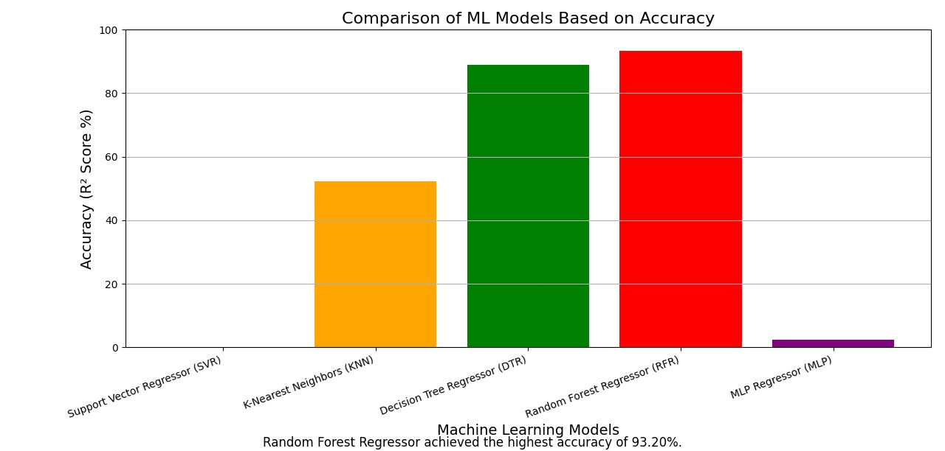

Slide 9
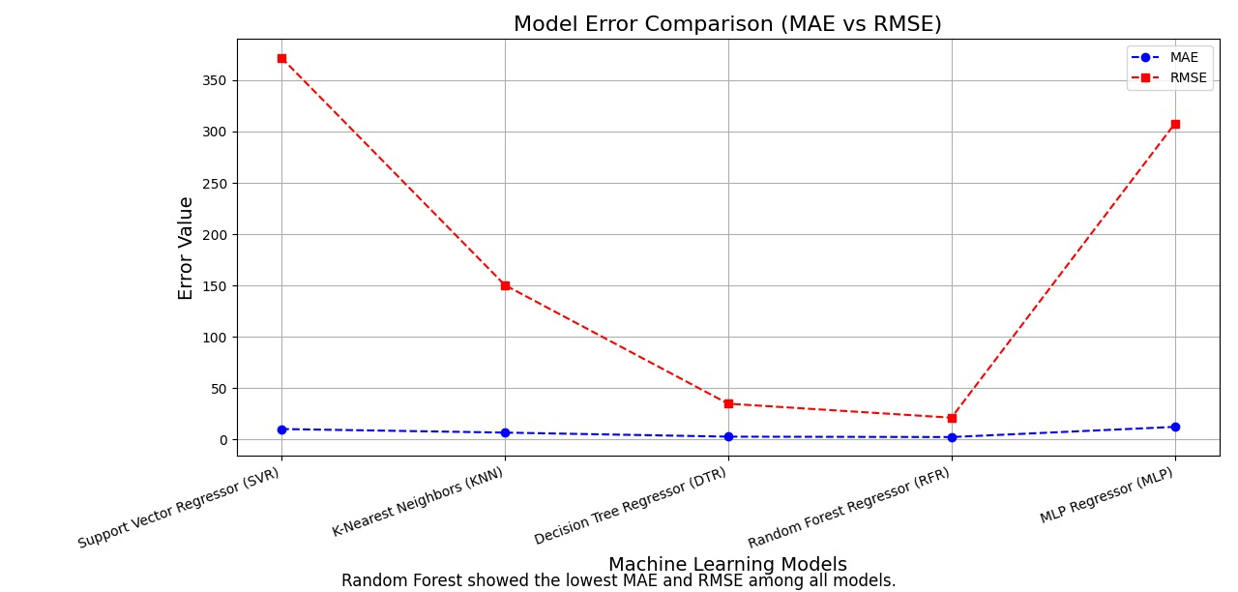

Slide 10
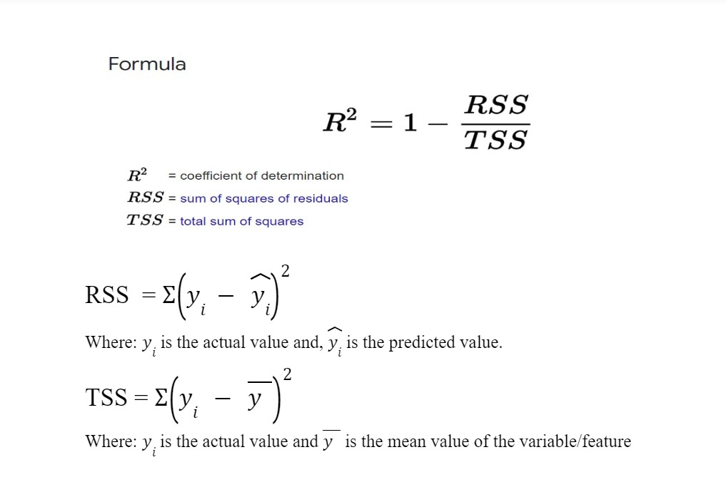
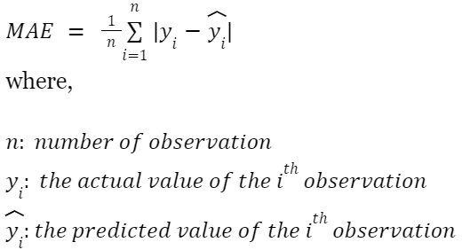
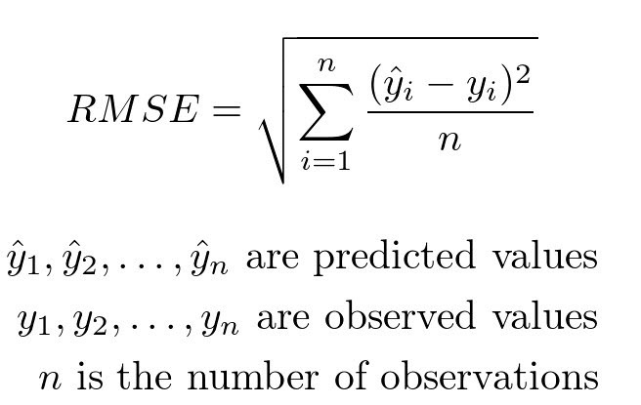

Slide 11
Population Scaling Logic
Dataset population = 2011 Census
Adjusted using +1% growth per year.
Updated Pop=Base Pop+(0.01×Years Passed×Base Pop)

Slide 12
Flask Web Application
Framework used: Flask
Features:
Simple user interface (form to select inputs)
Connects to ML model (backend)
Shows prediction result clearly
Pages:
index.html → Form page
result.html → Result display

Slide 13
Results & Outputs
Outputs shown to user:
City, Crime Type, Year
Predicted Crime Rate
Predicted Number of Cases
Crime Risk Level
Updated Population

Slide 14
Crime Risk Classification:
≤1 → Very Low
1–5 → Low
5–15 → High
15 → Very High

Slide 15
Thank You!!! 😊😊

